Slide 1

Clustering analyses: hierarchical, k-means, PCA

Slide 2
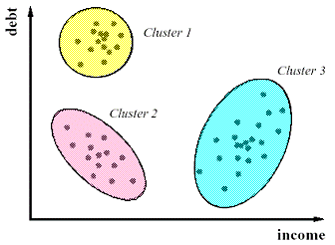
What are Clustering Analyses?
Techniques used to cluster data into groups (clusters)
according to similar properties
Tons of different algorithms/techniques available to do this
Why is this helpful?
Good for exploratory data mining – looking for patterns
What is interesting in this dataset?
Better understand/analyze your data
What are the main sources of variability?
What genes are clustering together in response to treatment?
Probably a ton more

Slide 3
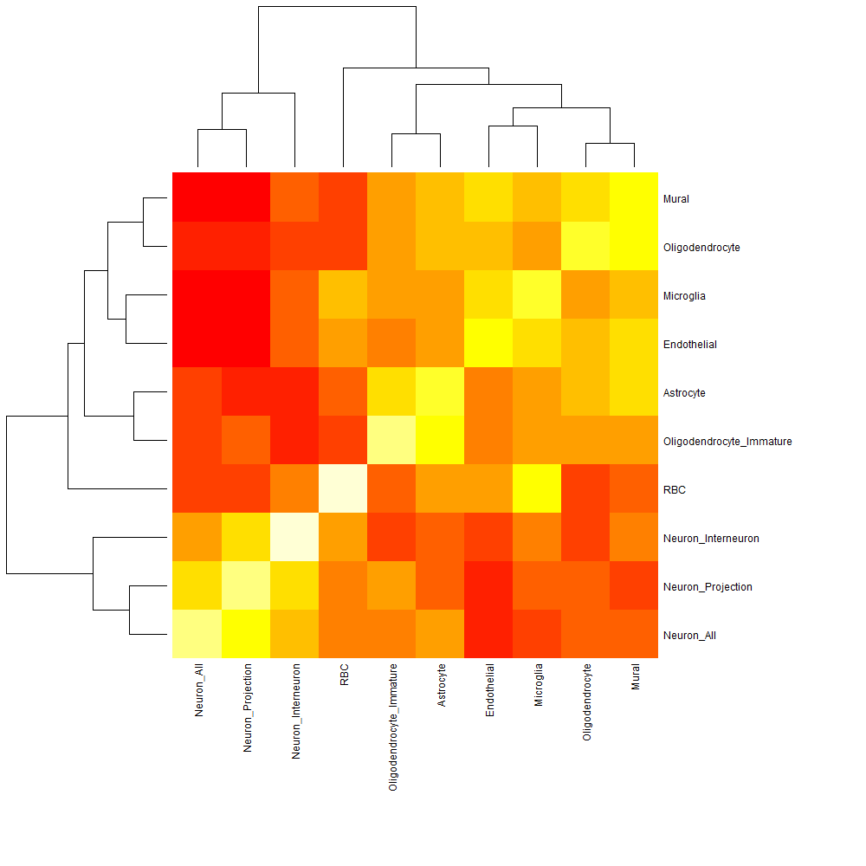

Hierarchical Clustering
Clusters data according to similarity hierarchies
Two main types:
Bottom-up (Agglomerative clustering)
Top-down (Divisive clustering)

Slide 4
Bottom-up (Agglomerative clustering)
Algorithm starts with individual clusters and links similar pairs of clusters together as it moves up

Slide 5
Top-down (Divisive clustering)
Algorithm starts with one cluster then divides into smaller clusters based on specified criteria and perform “cuts”
Shape
Color

Slide 6
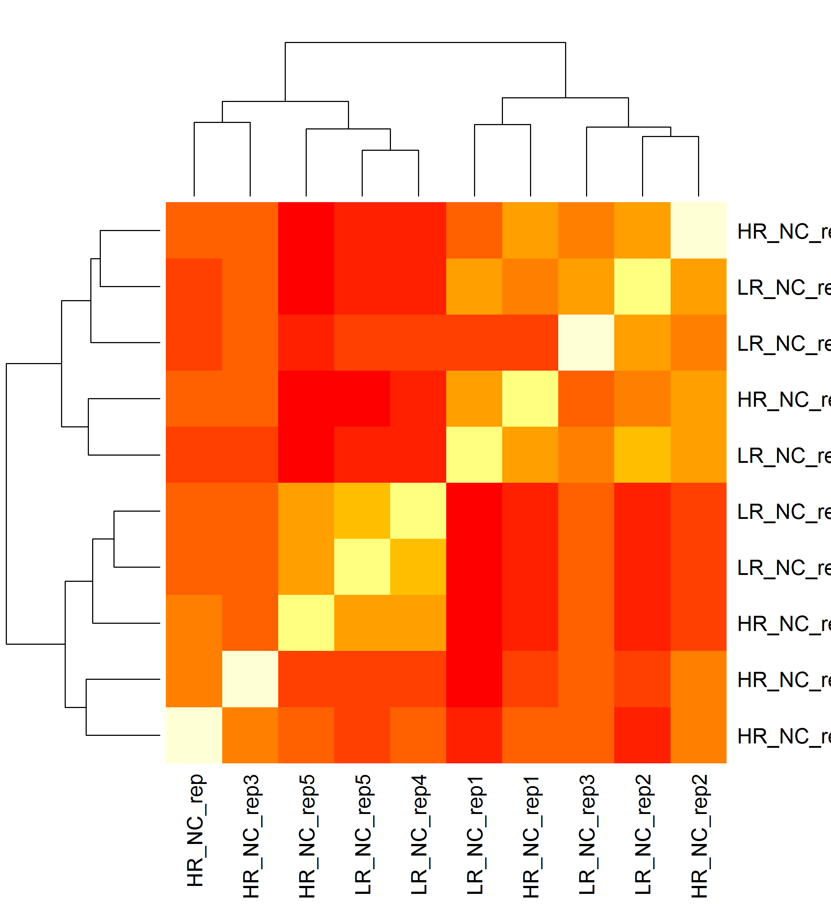
Hierarchical Clustering Heatmaps
Because other functions wouldn’t work… (“cluster” package)
Heatmap of log data subject-subject correlations for the F34 microarray study by Sarah Clinton (in Alabama)
cor() <- input numerical matrix
heatmap() <- input cor output
HR_NC_rep1 HR_NC_rep2 HR_NC_rep3 HR_NC_rep HR_NC_rep5 LR_NC_rep1
HR_NC_rep1 1.0000000 0.9503413 0.9236906 0.9312937 0.9014825 0.9425603
HR_NC_rep2 0.9503413 1.0000000 0.9387496 0.9329476 0.9137701 0.9399597
HR_NC_rep3 0.9236906 0.9387496 1.0000000 0.9341185 0.9247624 0.9088531
HR_NC_rep 0.9312937 0.9329476 0.9341185 1.0000000 0.9254476 0.9096285
HR_NC_rep5 0.9014825 0.9137701 0.9247624 0.9254476 1.0000000 0.8817017
LR_NC_rep1 0.9425603 0.9399597 0.9088531 0.9096285 0.8817017 1.0000000
LR_NC_rep2 0.9369521 0.9528973 0.9239770 0.9144455 0.8983563 0.9499088
LR_NC_rep3 0.9289718 0.9444564 0.9334379 0.9277650 0.9237286 0.9288912
LR_NC_rep4 0.9065147 0.9187743 0.9251066 0.9264691 0.9416004 0.8905278
LR_NC_rep5 0.9030260 0.9170764 0.9246238 0.9231333 0.9409178 0.8895797

Slide 7
K-means Clustering
Somewhat similar to divisive clustering in that you specify the number of clusters you wish to end with
Rather than relying on “cuts”, clusters according to distance from the k-mean
Generally uses Euclidean distance

Slide 8
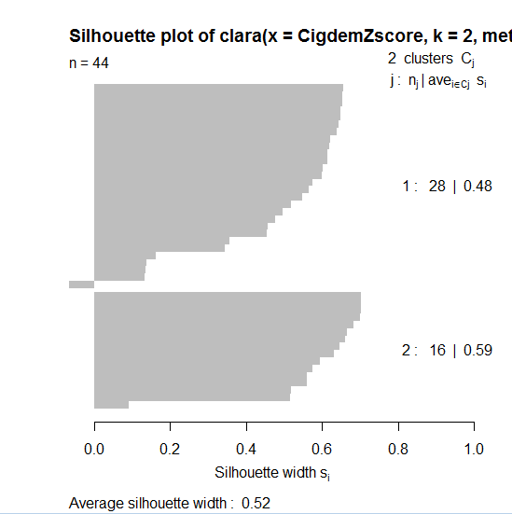
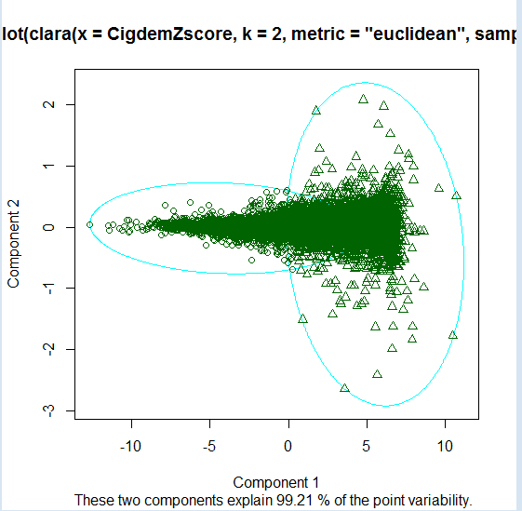
Clara() Function in the “cluster” Package
Example Output
Outputs string of plots like those on the right
Example of summary output below
Looks fancy, not sure what it means
ClustKCigdem
Object of class 'clara' from call:
clara(x = temp, k = 2, metric = "euclidean", samples = 10)
Medoids:
HR_1_Cigdem HR_2_Cigdem HR_3_Cigdem HR_4_Cigdem HR_5_Cigdem
Mid2 5.300613 5.079391 5.166669 5.236764 5.377388
AABR07065010.1 1.510453 1.767564 1.602222 1.697449 1.696993
LR_1_Cigdem LR_2_Cigdem LR_3_Cigdem LR_4_Cigdem LR_5_Cigdem
Mid2 5.388846 5.304591 5.240949 5.281461 5.349370
AABR07065010.1 1.871040 1.900688 1.773380 1.661191 2.005864
Objective function: 3.98052
Numerical information per cluster:
size max_diss av_diss isolation
[1,] 9667 28.53734 3.629499 2.558792
[2,] 6727 22.40375 4.484953 2.008826
Average silhouette width per cluster:
[1] 0.4830482 0.5942426
Average silhouette width of best sample: 0.5234825

Slide 9
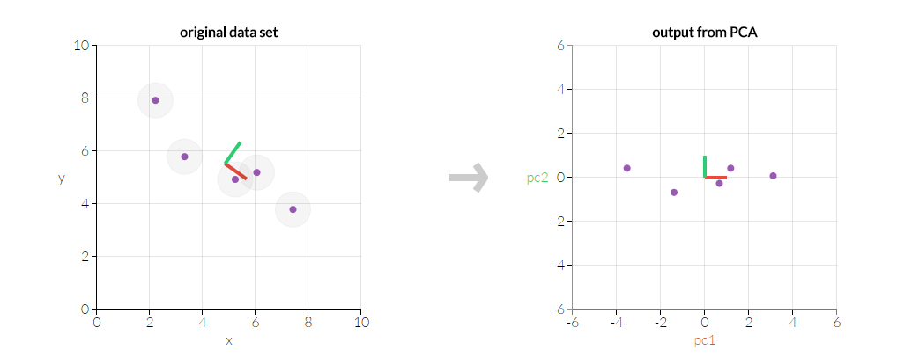
Principal Component Analysis (PCA)
Uses orthogonal transformation to convert variables that might be correlated into linearly uncorrelated variables called principal components
The principal components (PC) are organized in a way that the first PC accounts for the largest source of variability in the data, and the second PC accounts for the second most source of variability in the data and so on.

Slide 10
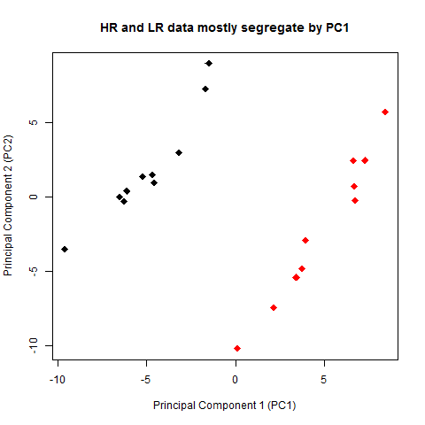
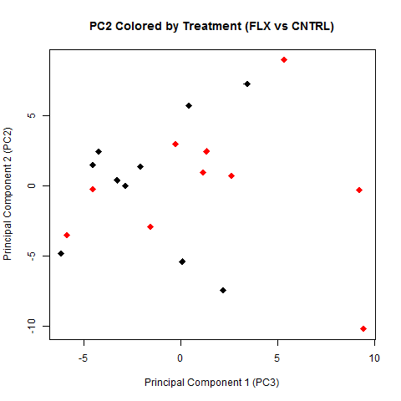
PCA on Cigdem’s RNA-seq Data
PCA on Cigdem’s RNA-seq data shows that the main source of variance is by phenotype
The second PC looks like it may possibly be due to treatment (FLX vs CNTRL) but not as strongly as phenotype
This is useful information – PCA is cool

Slide 11
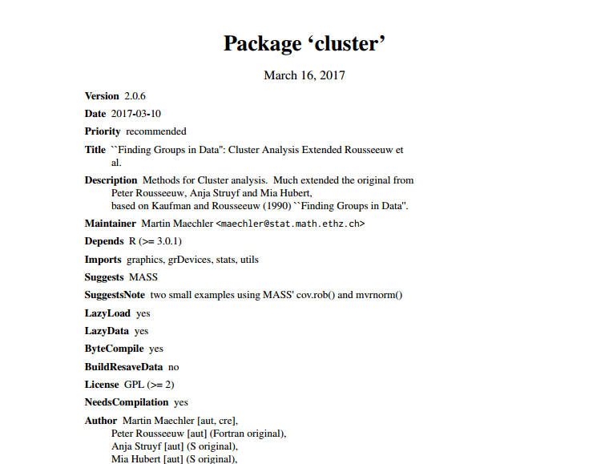
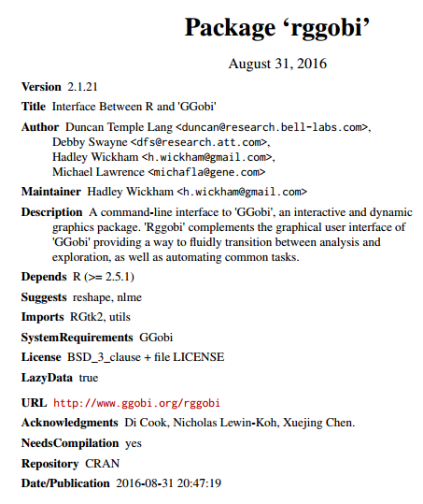
“Cluster” Package, “rggobi”, and More…
“cluster” contains many different types of clustering techniques
Would be helpful to go through functions that look most interesting
“rggobi” is mainly for visualization – looks really fancy
Tons of other packages/functions available for R alone
Also tons of options for other clustering software outside of R
Worth sticking to R or exploring outside?

Slide 12
Two facts:
(i) Correlation is the covariance of the z-scores.
(e.g. see here about four-fifths of the way down the page; alternatively, try
zx = scale(x) # this returns z-scores directly, but you can use your form instead
zy = scale(y)
cov(zx,zy);cor(x,y)
to see that covariance of z-scores and correlation are the same.
(ii) If you takes z-scores of z-scores you get z-scores. You can see this by direct reasoning (if the mean and standard deviation are already 0 and 1, you change nothing by subtracting 0 and dividing by 1), and you can double-check by looking at scale(scale(x))
Hence the correlation of the z-scores is the covariance of the z-scores of the z-scores, which is just the covariance of the z-scores, which is just the correlation of the original scores.

